Slide 1
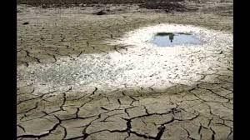
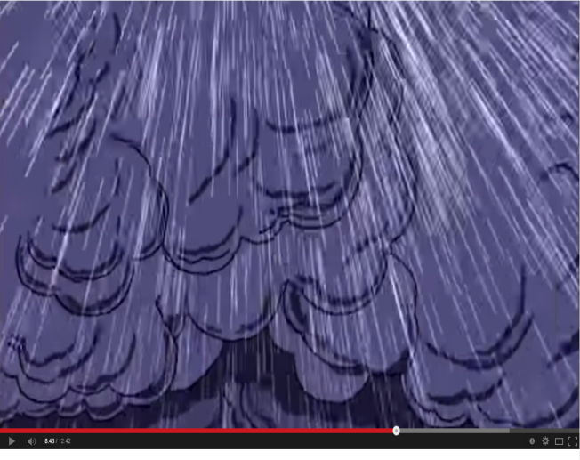
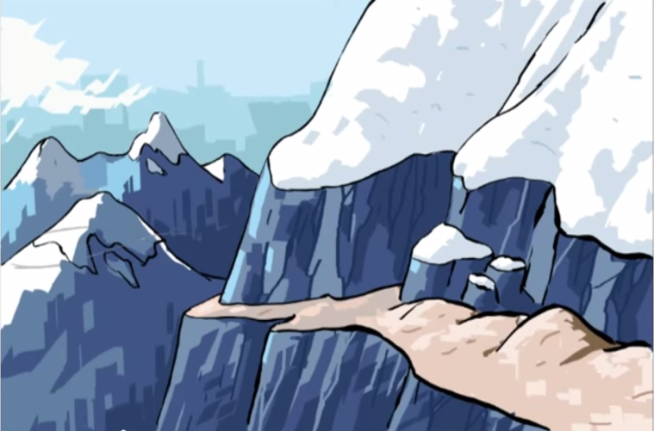
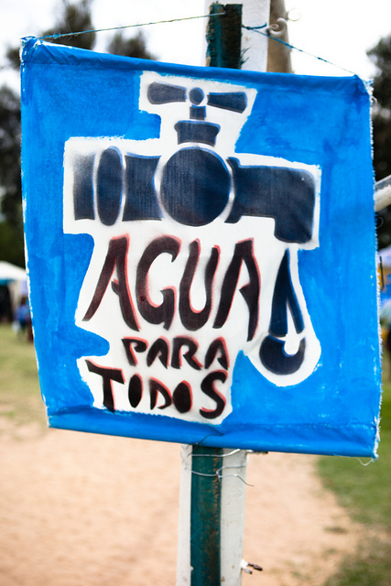
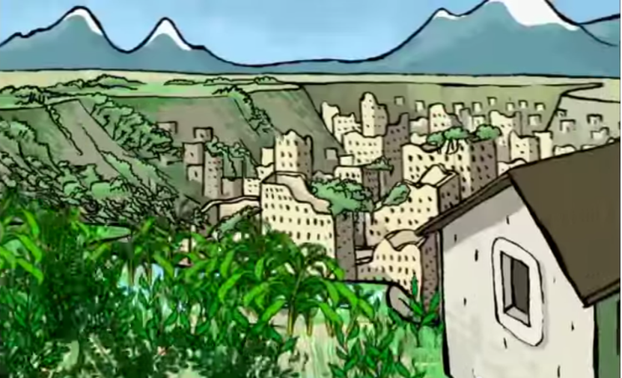
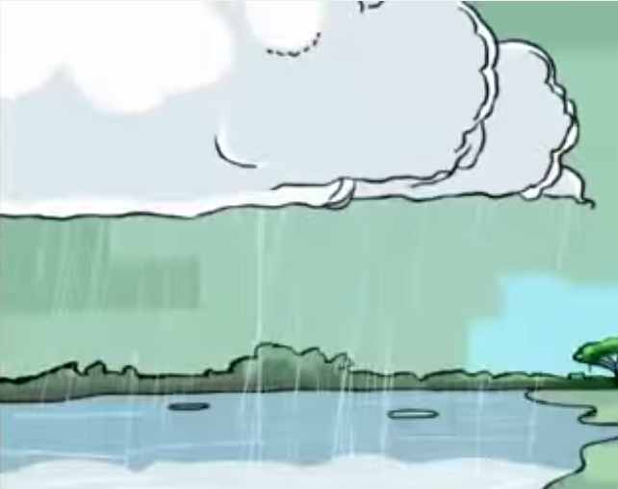
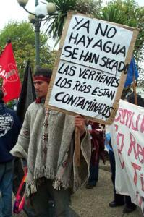
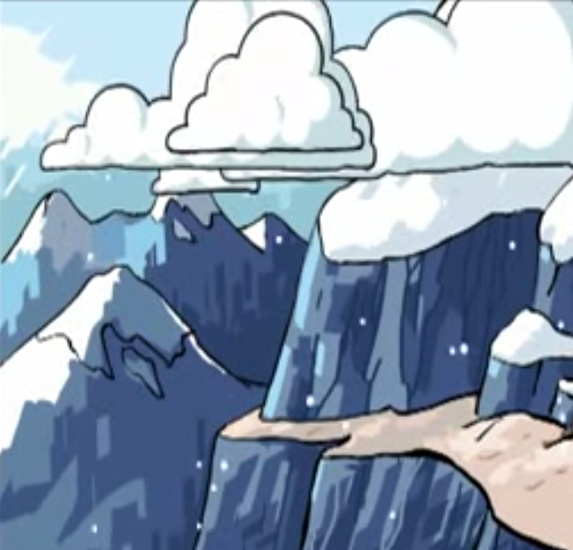
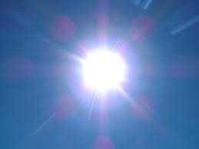
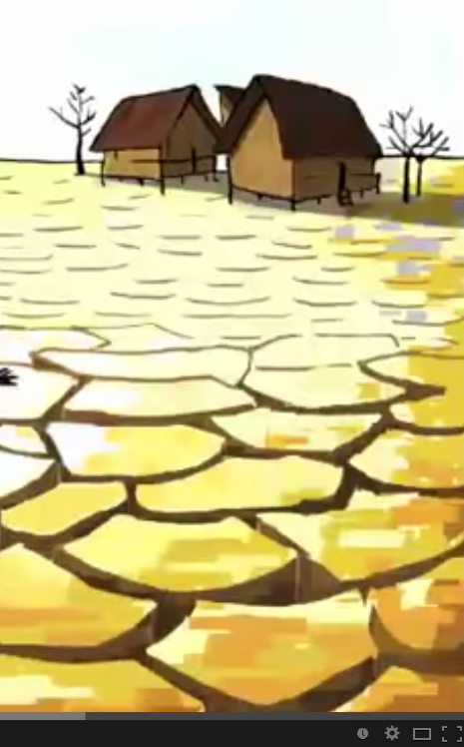
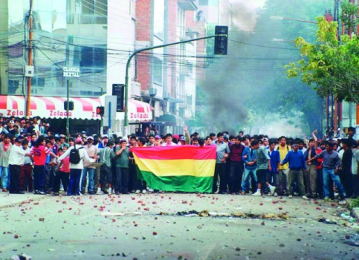
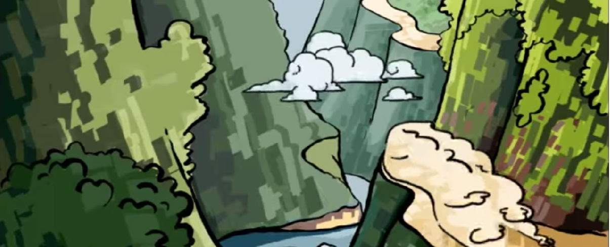
Habla en parejas y contesta las preguntas
1) ¿Qué vamos a aprender hoy?
2) ¿Donde está?
3) ¿Cuál es la historia de los fotos?
Notes:
Starter: When seated students are shown these photos from the film Abuela Grillo/ Bolivia and the water war and are posed 3 questions:
What are we going to learn today?
Where is this place?
What is the story behind the photos?

Slide 2
Título:
El Tiempo
(The weather)
Objetivo: To learn about the weather
in a Spanish speaking country using film.
All: say what the weather is like using 2 weather vocab items and have deeper cultural understanding of a spanish speaking country.
Most: as above and be able to ask what the weather is like and reply using 2 or more vocab items.
Some: as above and will also be able to use connectives to make longer sentences.
Notes:
Students write the objective and differentiated outcomes are explained to class.

Slide 3
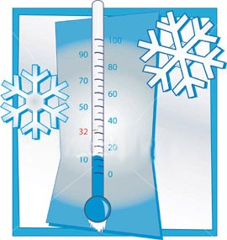
Notes:
PPP: introduction of weather 8x slides with images from the film so students are familiar with pronunciation.

Slide 9
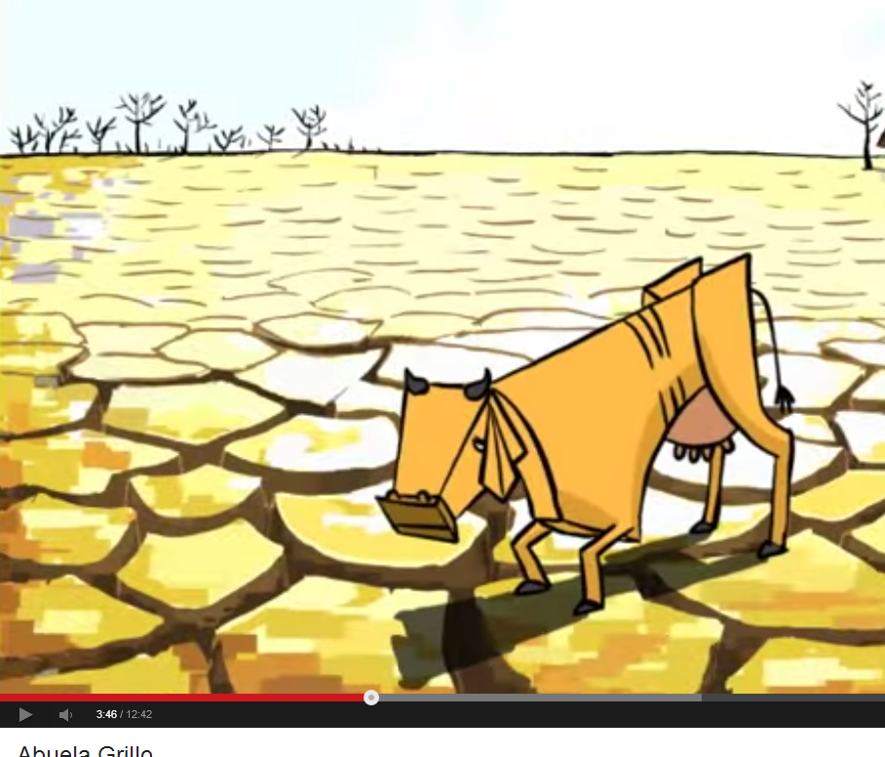

Slide 10
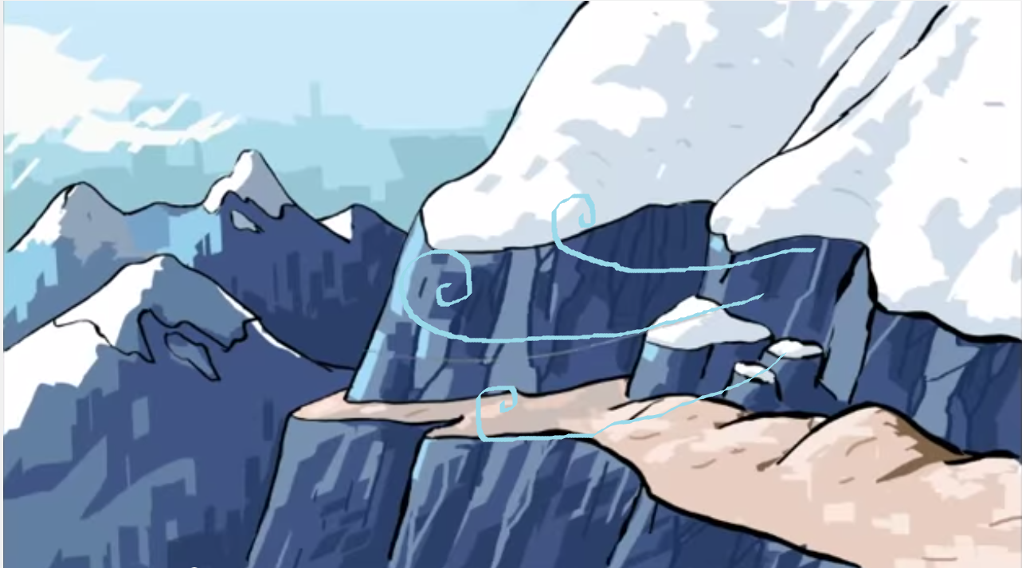

Slide 11
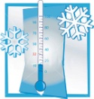
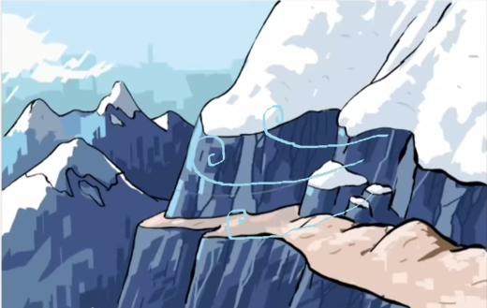
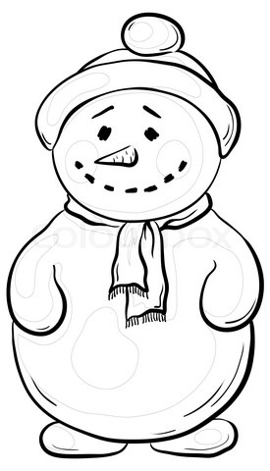
Can you crack the code to find out how to spell
the different types of weather in Spanish??
1) H1c2 fr34
5) Ll52v2
Hace frío
Llueve
*This letter has an accent
2) H1c2 c1L4r
6) H1c2 v32nt4
Hace calor
Hace viento
3) H1c2 s4l
7) H1y t4rm2nt1
Hace sol
Hay tormenta
4) N32v1
8) H1y n5b2s
Hay nubes
Nieva
Notes:
Students given worksheet. They write out the weather in Spanish cracking the code. Code underneath for less able st
A= 1
E=2
I=3
O=4
U=5

Slide 12
Escucha y escribe.
Actividad uno: Escucha el video y excribe el tiempo correcto.
1)
2)
3)
4)
5)
http://youtu.be/kwC5uI979HU
llueve nieva hace viento hay tormenta
hace sol hace frío hace calor hay nubes
¿¿Terminado??
Actividad dos: Listen to the person singing in the film. Draw a picture of what you think they look like.
Think about: Nationality, clothes, age, male or female?????
Notes:
Students listen to an edited clip of the film where they can hear the different types of weather and write them down in order. (Listen 2x/ 3x times)
Extra task: to draw the person they hear singing encourage them to think about sex, age, where the person comes from, what they do. At the end watch the film.
After film: Discussion: Where do you think the film is set

Slide 13
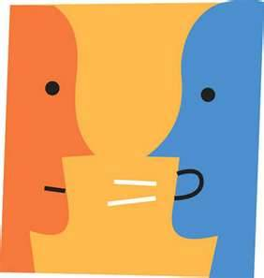
Piensa
Empareja
Comparte
¿Dónde?
Where is the film set? Why do you think this?
¿Qué?
What is the message the film is sending?
¿Cuál?
Which was your favourite part in the film?
¿Quién?
Who is your favourite character? Why?

Slide 14
A: ¿Qué tiempo hace en Bolivia?
¡Habla!
B: En Bolivia........ y
B: ¿Qué tiempo hace hoy?
A: Hoy.......
Remember to use:
Connectives: Time phrases:
pero, también, y A veces, siempre,
porque normalmente,

Slide 15
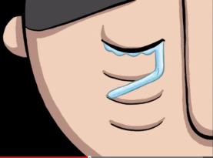
Los deberes
Find 5 facts about the Bolivian water war or the legend of Abuela Grillo to share with the class.
Something to think about: Can you think of any legends or wives tales about the weather such Abuela Grillo??

